Slide 1
Decision Trees.

Slide 2
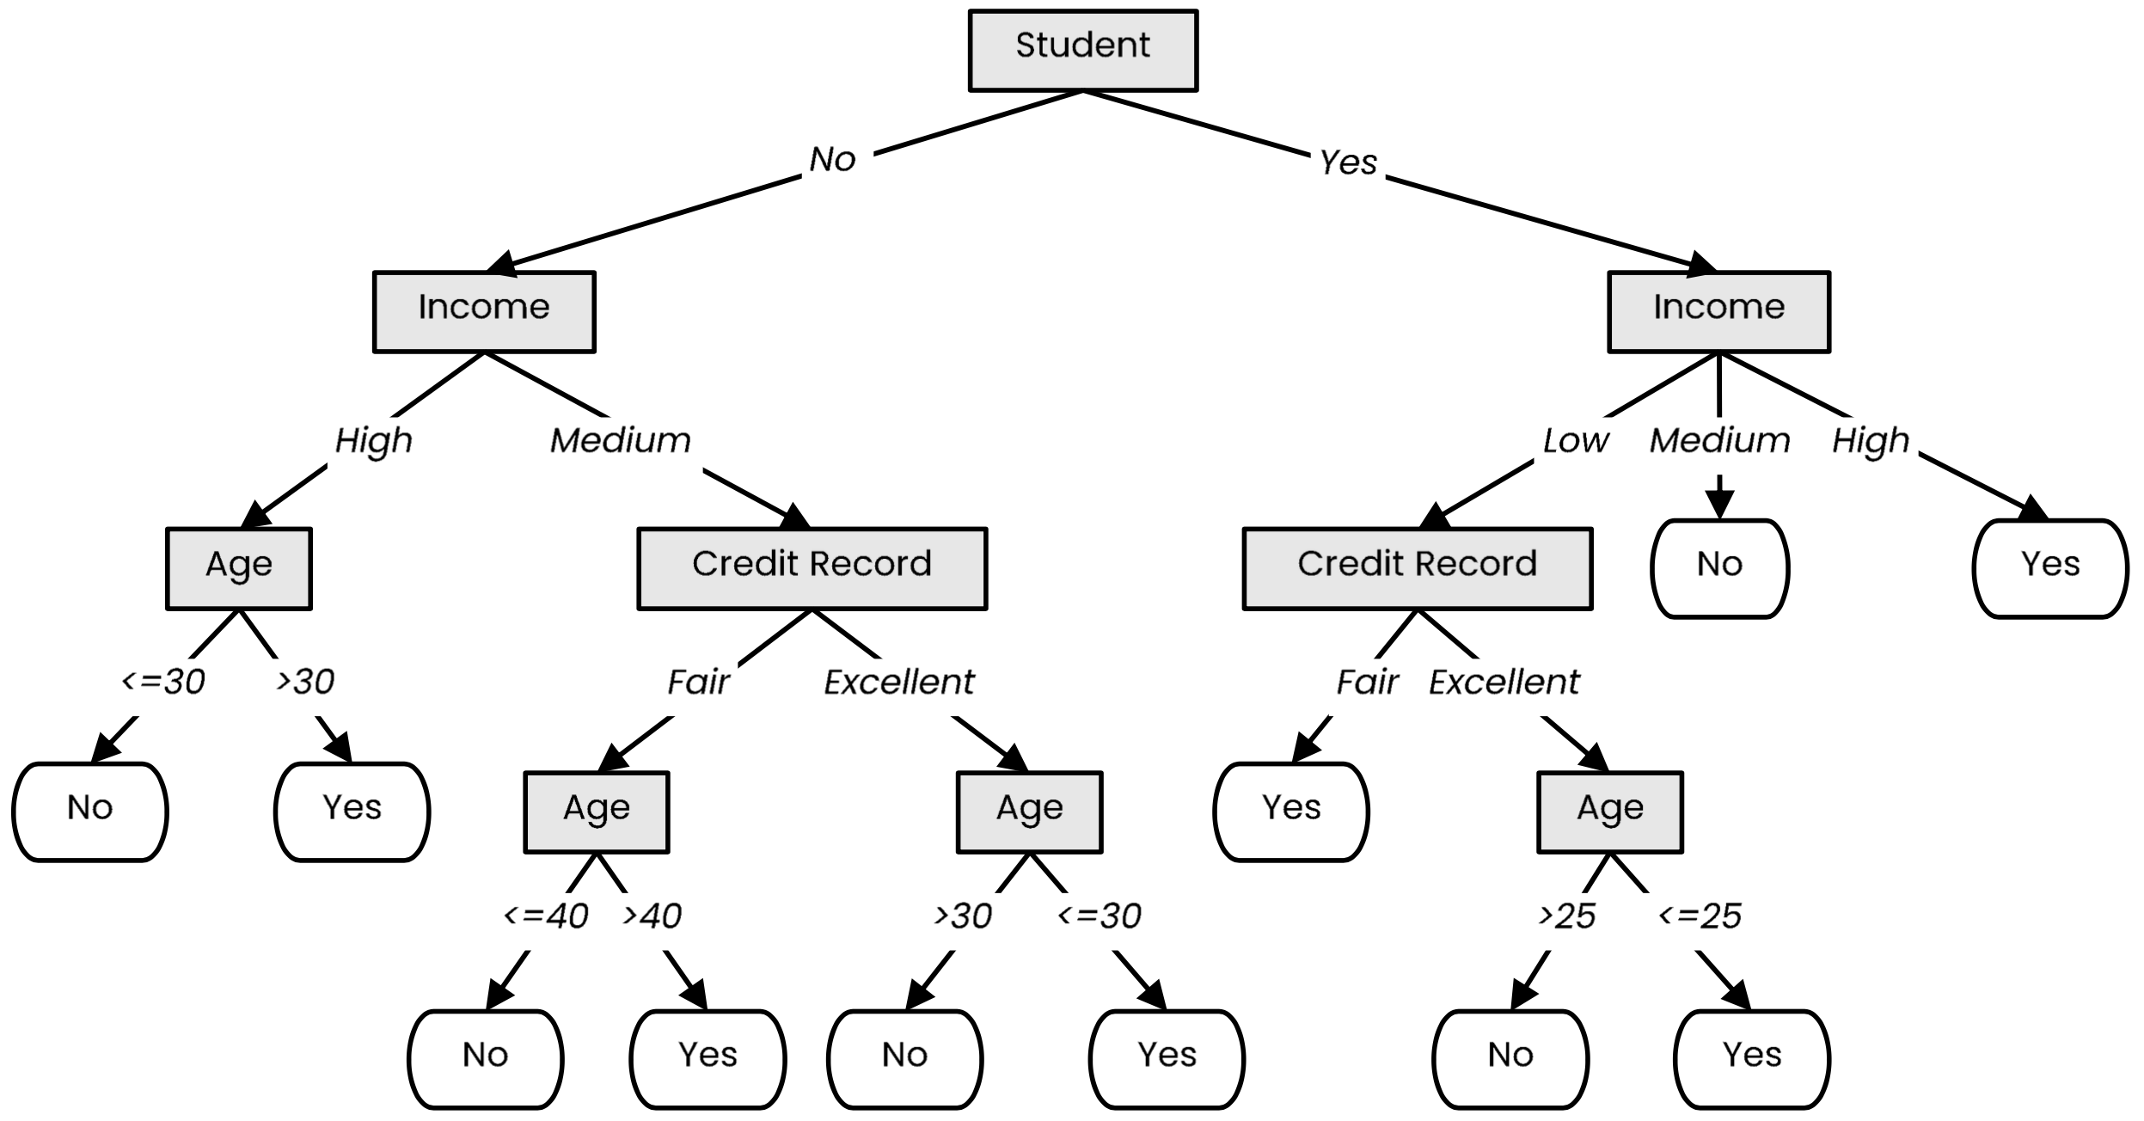
Definition
A tree-like model that illustrates series of events leading to certain decisions
Each node represents a test on an attribute and each branch is an outcome of that test
Who to loan?
Not a student
45 years old
Medium income
Fair credit record
Student
27 years old
Low income
Excellent credit record

Slide 3
Decision Tree Learning
We use labeled data to obtain a suitable decision tree for future predictions
We want a decision tree that works well on unseen data, while asking as few questions as possible

Slide 4
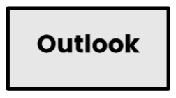
Decision Tree Learning
Basic step: choose an attribute and, based on its values, split the data into smaller sets
Recursively repeat this step until we can surely decide the label

Slide 5
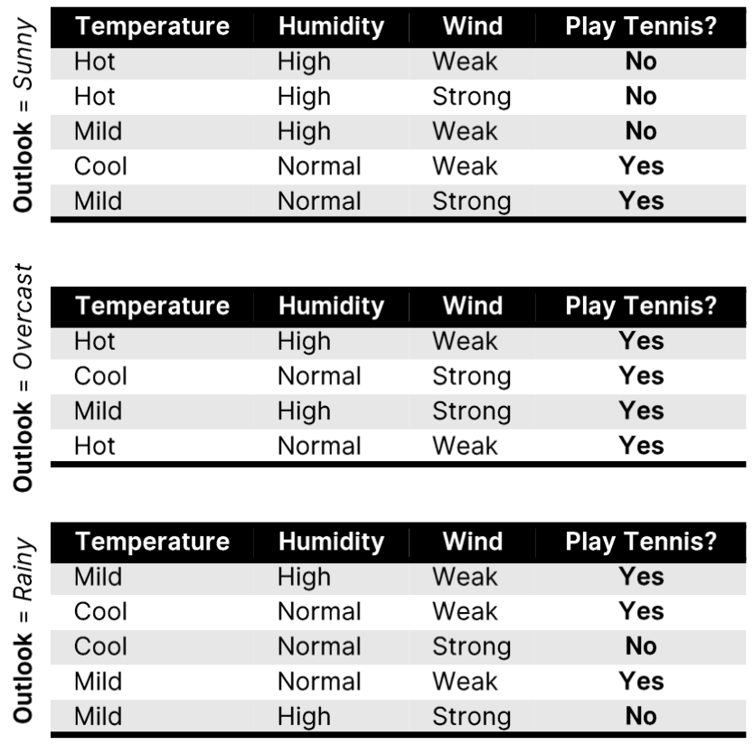
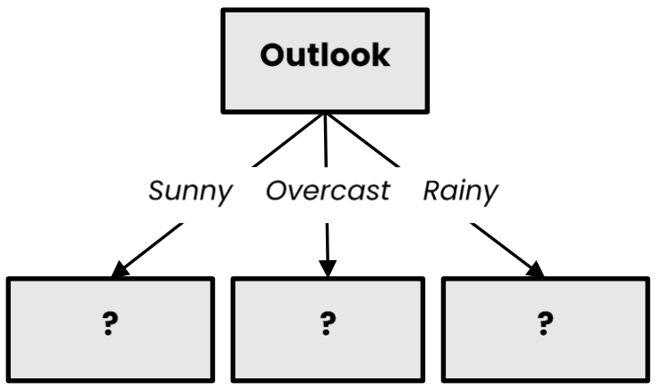
Decision Tree Learning
Basic step: choose an attribute and, based on its values, split the data into smaller sets
Recursively repeat this step until we can surely decide the label

Slide 6
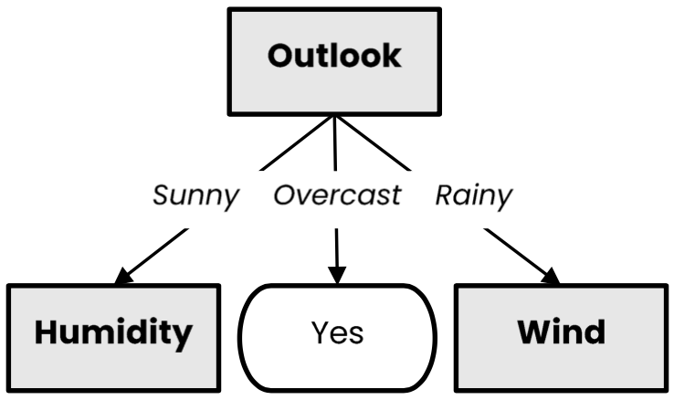
Decision Tree Learning
Basic step: choose an attribute and, based on its values, split the data into smaller sets
Recursively repeat this step until we can surely decide the label

Slide 7
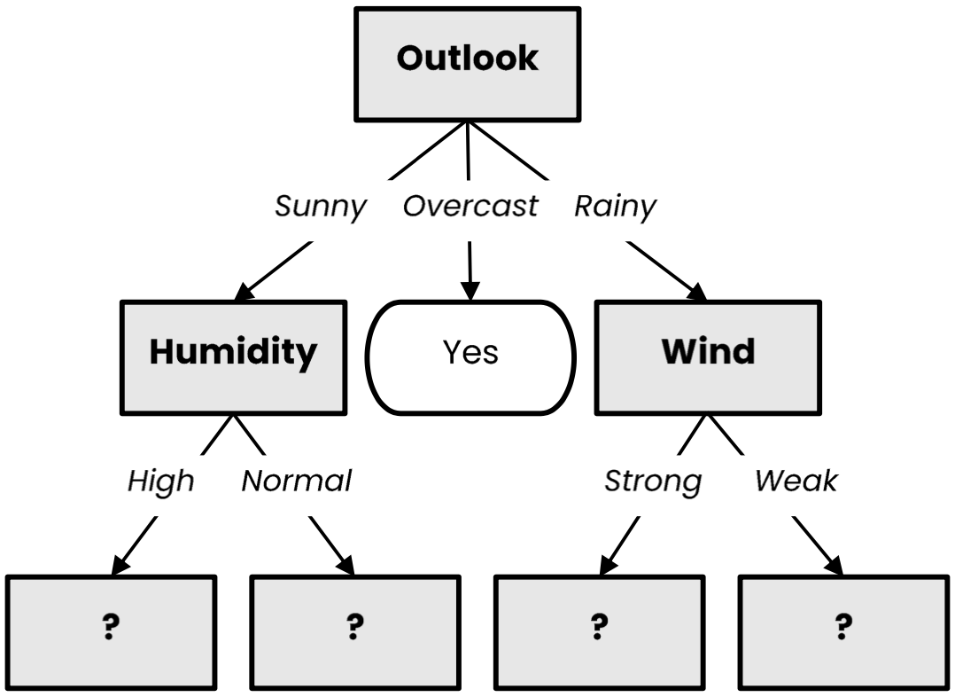
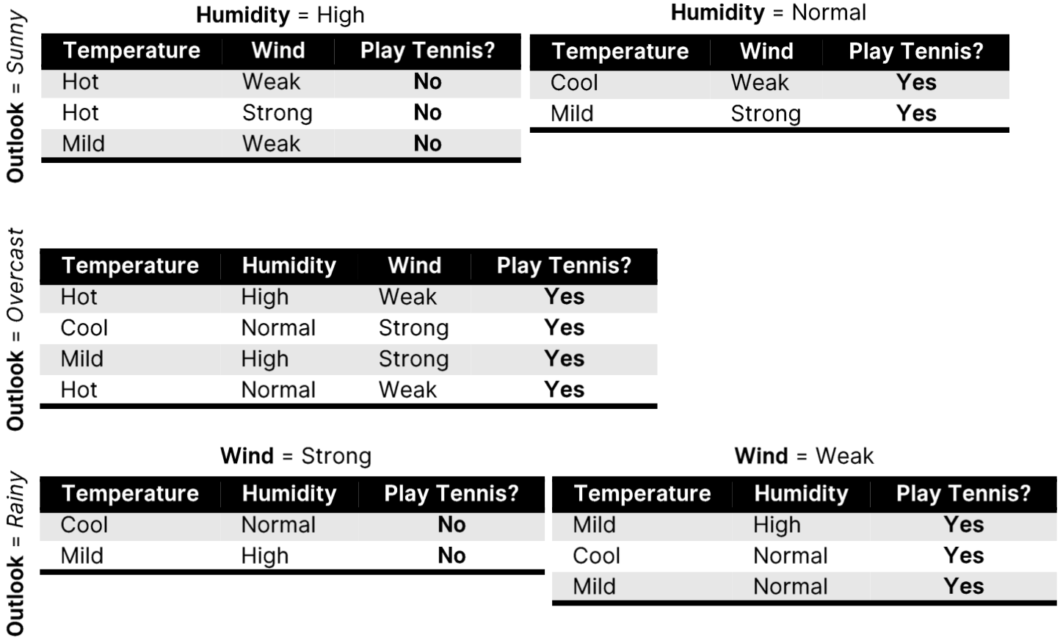
Decision Tree Learning
Basic step: choose an attribute and, based on its values, split the data into smaller sets
Recursively repeat this step until we can surely decide the label

Slide 8
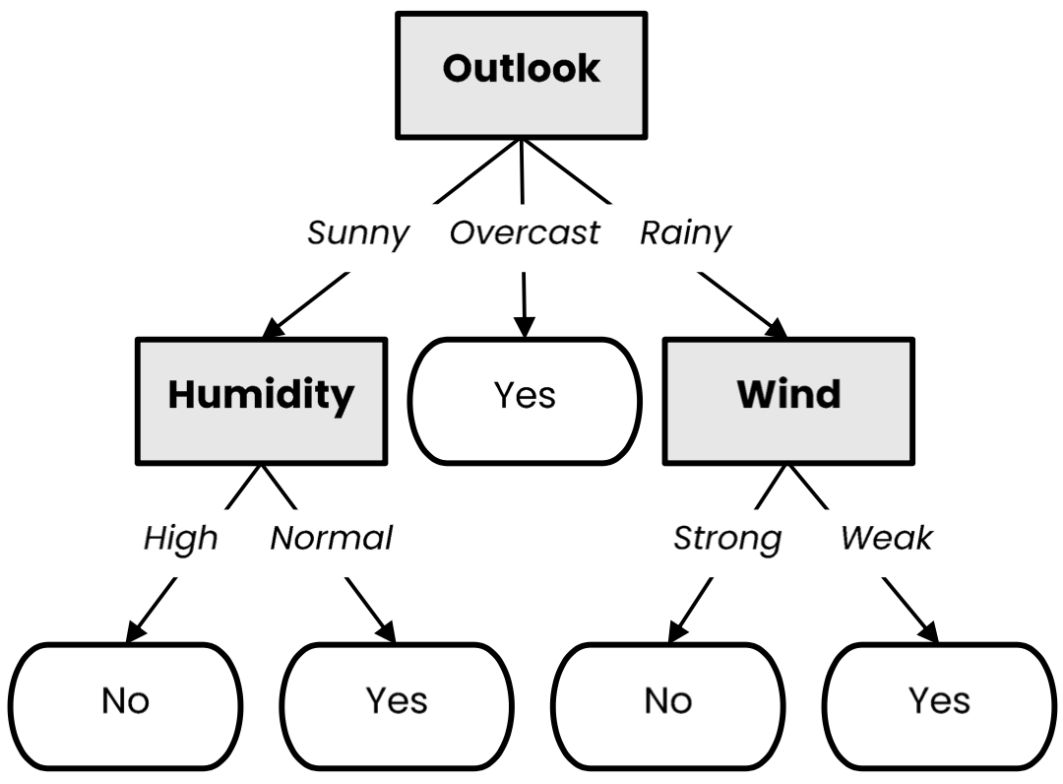
Decision Tree Learning
Basic step: choose an attribute and, based on its values, split the data into smaller sets
Recursively repeat this step until we can surely decide the label

Slide 9
Decision Tree Learning (Python)
def make_tree(X):
node = TreeNode(X)
if should_be_leaf_node(X):
node.label = majority_label(X)
else:
a = select_best_splitting_attribute(X)
for v in values(a):
𝑋_{𝑣} ={𝑥 ∈ 𝑋|𝑥[𝑎] == 𝑣}
node.children.append(make_tree(𝑋_{𝑣}))
return node

Slide 10






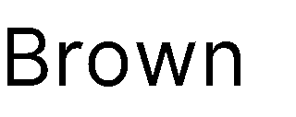

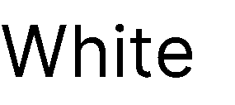
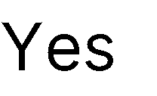

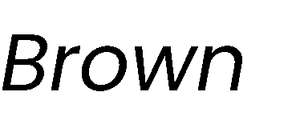
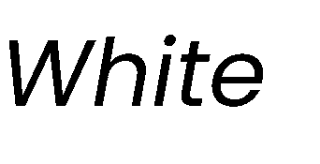


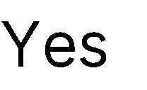
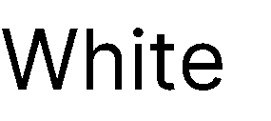

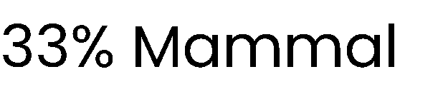
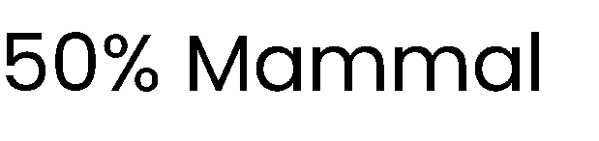
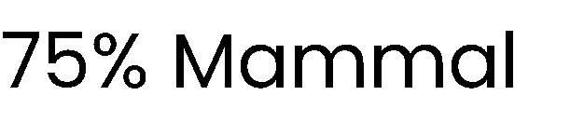
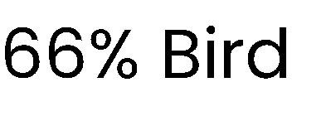
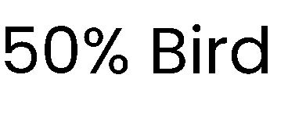
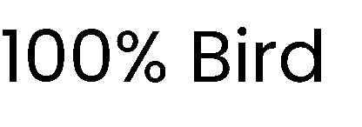
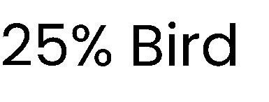
What is a good attribute?
Which attribute provides better splitting?
Why?
Because the resulting subsets are more pure
Knowing the value of this attribute gives us more information about the label
(the entropy of the subsets is lower)

Slide 11






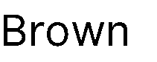

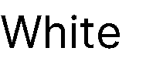
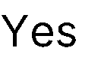

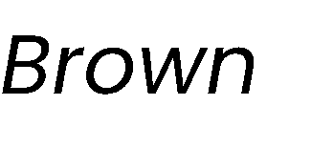

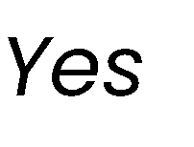
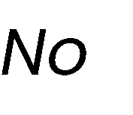

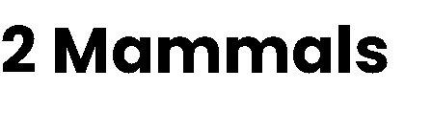
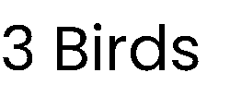
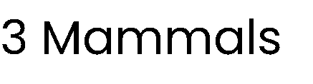
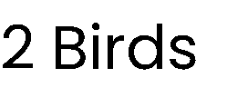
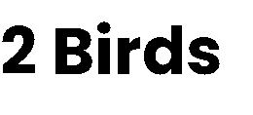
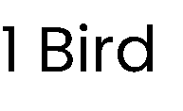
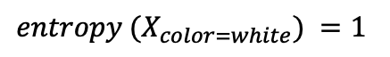
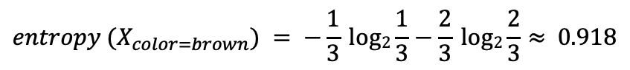
Best attribute = highest information gain
$$entropy \left(X\right)= − pmammal log2 pmammal−pbird log2 pbird=−\frac{3}{7} log2\frac{3}{7}−\frac{4}{7}log2\frac{4}{7}≈ 0.985$$
$$entropy (X_{color=brown}) = −\frac{1}{3} log2\frac{1}{3}−\frac{2}{3} log2\frac{2}{3}≈ 0.918$$
$$entropy (X_{color=white}) =1$$

Slide 12
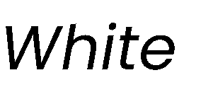

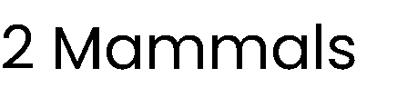
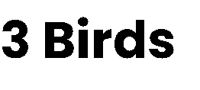
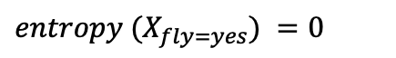
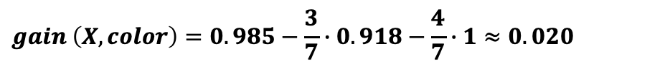
Best attribute = highest information gain
$$entropy \left(X\right)= − pmammal log2 pmammal−pbird log2 pbird=−\frac{3}{7} log2\frac{3}{7}−\frac{4}{7}log2\frac{4}{7}≈ 0.985$$
$$entropy (X_{color=brown}) = −\frac{1}{3} log2\frac{1}{3}−\frac{2}{3} log2\frac{2}{3}≈ 0.918$$
$$entropy (X_{color=white}) =1$$
$$gain \left(X, color\right)=0.985−\frac{3}{7}∙0.918−\frac{4}{7}∙1≈0.020$$
$$entropy (X_{fly=yes}) =0$$

Slide 13
Pruning

Slide 14
Pruning
Pruning is a technique that reduces the size of a decision tree by removing branches of the tree which provide little predictive power
It is a regularization method that reduces the complexity of the final model, thus reducing overfitting
Decision trees are prone to overfitting!
Pruning methods:
Pre-pruning: Stop the tree building algorithm before it fully classifies the data
Post-pruning: Build the complete tree, then replace some non-leaf nodes with leaf nodes if this improves validation error

Slide 15
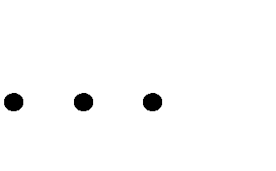
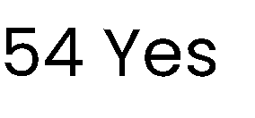
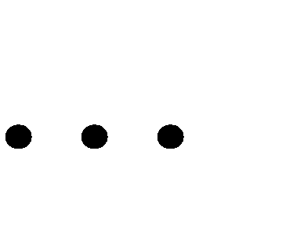
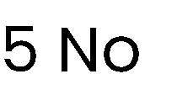
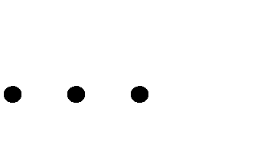
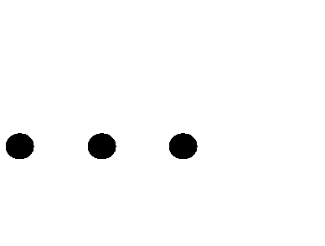
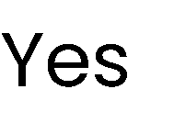
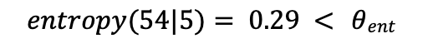
Pre-pruning
Minimum threshold on entropy
𝜽_{𝒆𝒏𝒕} = 𝟎. 𝟒
Pre-pruning implies early stopping:
If some condition is met, the current node will not be split, even if it is not 100% pure
It will become a leaf node with the label of the majority class in the current set
(the class distribution could be used as prediction confidence)
Common stopping criteria include setting a threshold on:
Entropy (or Gini Impurity) of the current set
Number of samples in the current set
Gain of the best-splitting attribute
Depth of the tree
$$entropy(54|5)= 0.29 < θent$$
Stop, even if node can be split
91.52% confidence

Slide 16
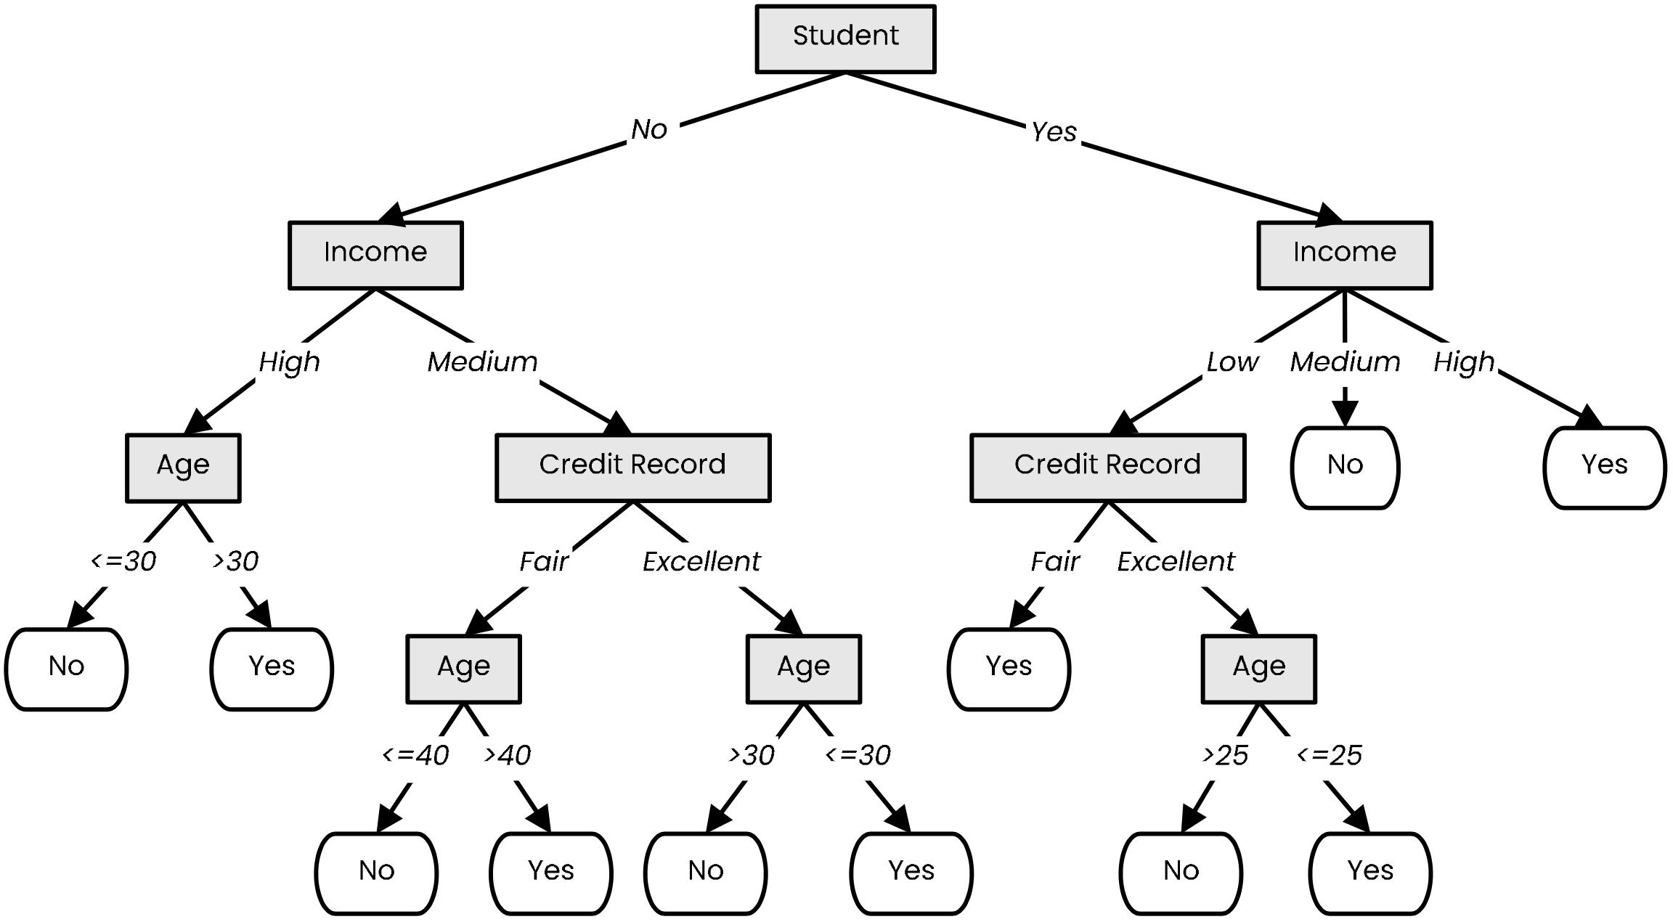




Post-pruning
Prune nodes in a bottom-up manner, if it decreases validation error

Slide 17

Post-pruning
Prune nodes in a bottom-up manner, if it decreases validation error

Slide 18

Post-pruning
Prune nodes in a bottom-up manner, if it decreases validation error

Slide 19



Decision Boundaries
Decision trees produce non-linear decision boundaries
Support Vector Machines
Decision Tree

Slide 20








Decision Trees: Training and Inference
Training
Inference

Slide 21
Summary
Decision trees represent a tool based on a tree-like graph of decisions and their possible outcomes
Decision tree learning is a machine learning method that employs a decision tree as a predictive model
ID3 builds a decision tree by iteratively splitting the data based on the values of an attribute with the largest information gain (decrease in entropy)
Using the decrease of Gini Impurity is also a commonly-used option in practice
C4.5 is an extension of ID3 that handles attributes with continuous values, missing values and adds regularization by pruning branches likely to overfit

